Slide 1
Programming with B4X
Lesson 20 – From B4J to B4A
Anywhere Software
April 2021

Slide 2
Today you will learn
How to move an application to B4A

Slide 3

Congratulations
B4Χ
B4J
B4A
B4I
B4R
In this last chapter you will deal with the conversion of a into a program for Android.
Notes:
Having completed the courses up to this point you can say that you have acquired a good knowledge of the language B4X. What you've learned so far it is only the beginning of the journey of the "art" of programming. In addition, the B4X language as discussed in previous chapters can be used to build mobile applications on both Android and IOS. With minimal changes and without having to learn new commands you can transfer an application written in Windows with B4J to Android and the language B4A.
In this last chapter you will deal with the conversion of a program (given ready) into a program for Android.

Slide 4
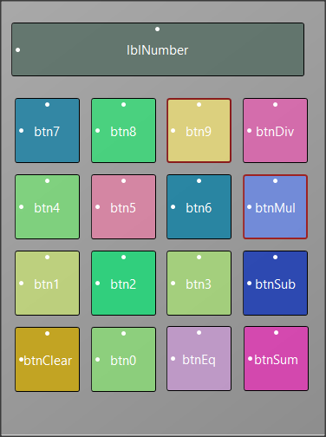
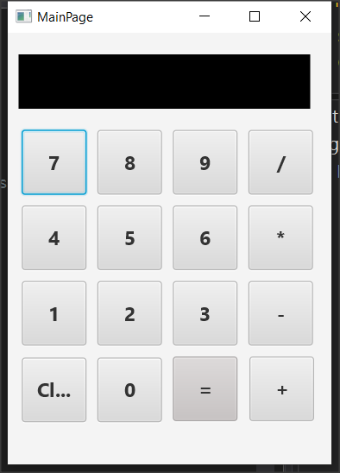
Application description in B4J
A simple calculator that performs
basic operations.
Notes:
The application is a simple calculator that performs basic operations.
The app consists of 16 different buttons and a label that displays the numbers.
The 10 buttons are the numbers from 0 to 9 and the rest are the basic operations, equality and clear.

Slide 5
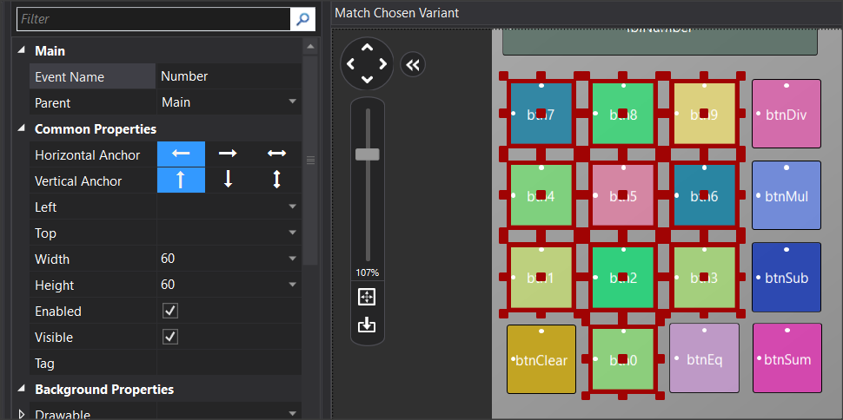
Events for buttons
How to handle so many events from buttons?
New Event
Tag
Notes:
In programs like the one that you need to manage multiple buttons, in or-der not to use separate events for each event _ click , it is possible to group the events _click. For example, after selecting all the buttons listed in the numbers from 0 to 9, then set the “Event Name” properties, for example Number. Now all buttons have a common click event named Number_Click. Also, for you to have a different value from each button you need to update the "tag"property. Assign a value to each different number. For example, in btnNumber1, set “tag” to 1, in btnNumber2 set “Tag” to 2 and so on.

Slide 6
Number_Click
Private Sub Number_Click
Dim b As Button
b = Sender
Log(b.Tag)
If done Then
lblNumber.Text = 0
done = False
End If
lblNumber.Text = lblNumber.Text & b.Tag
End Sub
Notes:
Now in the event take advantage of the Tag value to enter a new number.
Sender assigns the clicked button to variable b.

Slide 7
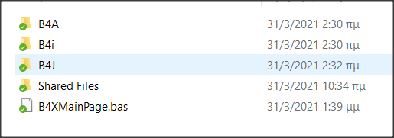
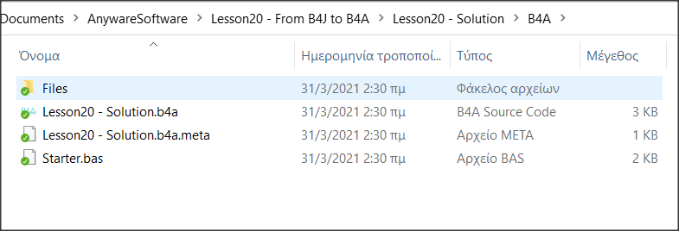
Transfer app to B4A and Android
Notes:
Already when you start an application the appropriate folder for B4A and B4i has already been created even though you are not using it yet.

Slide 8
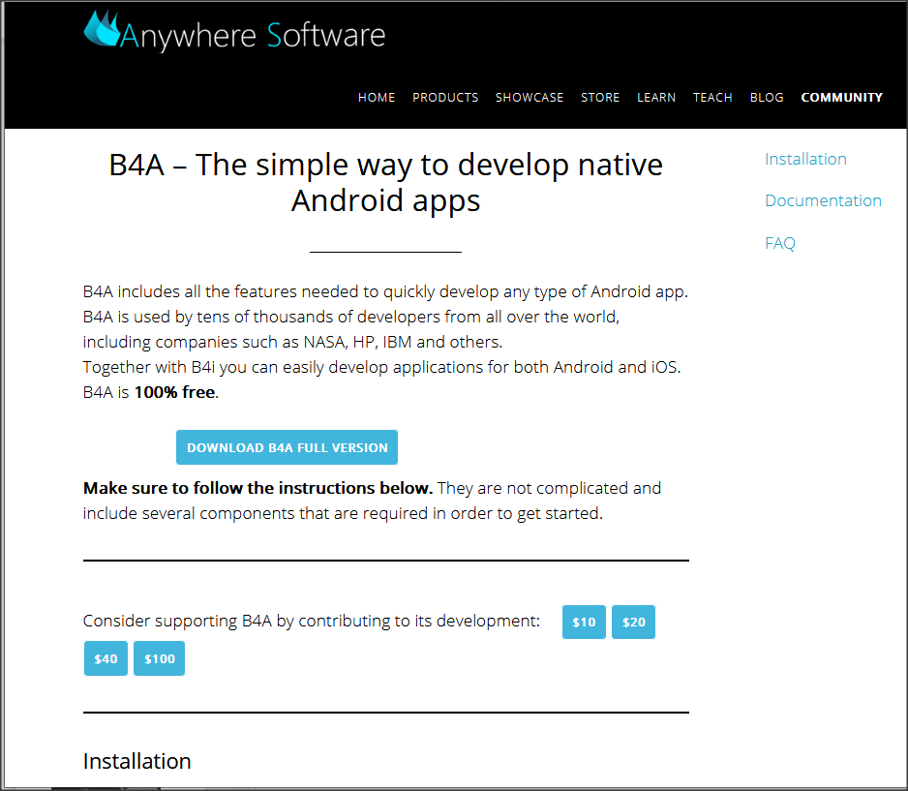
Download and Install B4A
https://www.b4x.com/b4a.html.
Notes:
To start the transfer, you will need to install the B4A. For instructions on installation, see the link https://www.b4x.com/b4a.html.
After you complete the installation do not forget to install on your mobile the application B4A-Bridge which will help you transfer the calculator to the mobile. The app is free to install from Google Play.

Slide 9
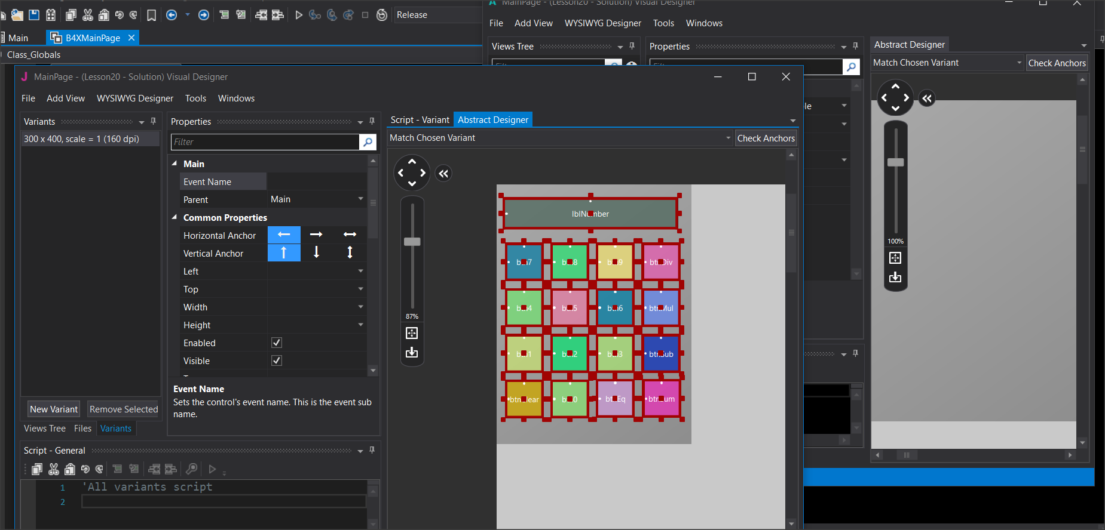
Transfer of design
Notes:
Open the calculator with B4J. Similarly open the calculator with B4A. The file of interest is located within the B4A folder and has a b4a extension. Already all the code of the application exists within the B4A!
Open the Designer which visually makes no difference to that of b4j.
The design has not been transferred to the B4A but you can easily select all objects from the designer of B4J by copying and pasting to the screen of the designer of B4A. You can also make any changes you want to make your app look. Finally, save the changes and return to B4A.

Slide 10
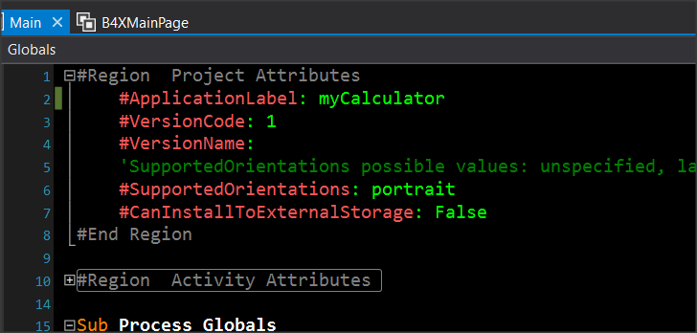
Set the Name of your app
Notes:
Before installing the app on a mobile device, you must specify the name of your app and the name of the "package" to be sent to the mobile.
From the tab Main specify the name you want the application to have in the directive #ApplicationLabel:
It's the name that will appear on the screen of your mobile phone or tablet.

Slide 11
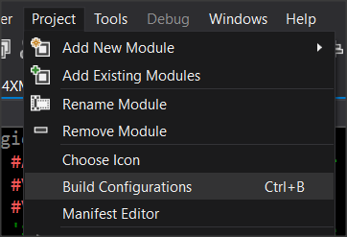
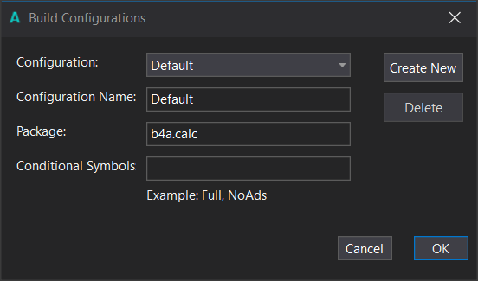
Set the package name
Notes:
From the Build Configurations menu, specify the name of thePackage:This should be something unique for your device, which is why it is recommended to start with"b4a.". In the example, the package name is "b4a. calc».

Slide 12
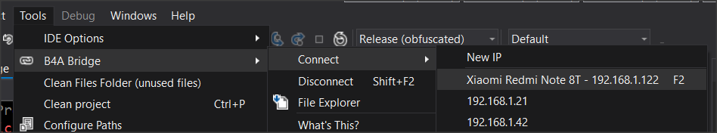
Selecting Phone from B4A-Bridge
Select your phone
Notes:
Select your device that should appear in the menu. If you can't find it, check to see if it's connected to your local area network.

Slide 13
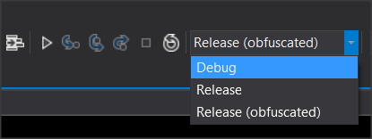
Run the compiler
Run
Notes:
Select the type of installation to perform. Debug if you are in the process of debuging the application and Release once you are finished with the deployment and want it to run independently of the development environment of B4A.

Slide 14
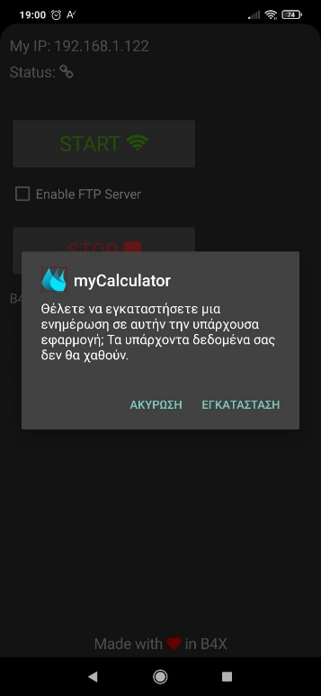
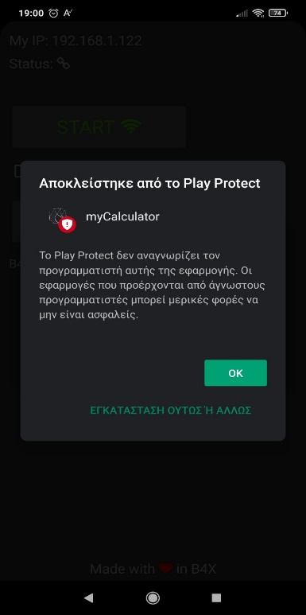
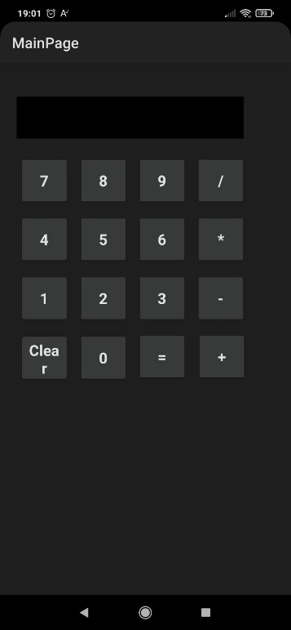
Install and Run
Blocked from Play Protect
Play Protect does not recognize the programmer of this application …
Do you want to install the application?
Cancel Install
INSTALL ANYWAY
Notes:
During installation, you may receive a message from Play Protect that you can ignore and continue.

Slide 15

Thank you!!!

